Slide 1
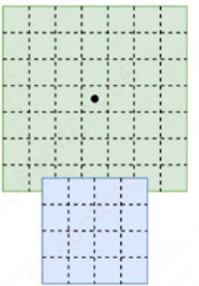


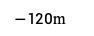
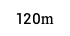




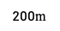


RT6 融合模型
$120$m
Point Cloud
Voxel Encoder
Backbone
& Neck
pts feat
$$\text{[}\text{576}\text{,}\text{576}\text{,}\text{128}\text{]}$$
$−120$m
BG Head
$$点云范围$$
$$\text{[}\text{576}\text{,}\text{576}\text{,}\text{128}\text{]}$$
$−120$m
$120$m
pts&cam
Fusion
Temporal
fusion
$$\text{[}\text{576}\text{,}\text{576}\text{,}\text{128}\text{]}$$
4c
Fisheye
Backbone
$$\text{[}\text{4}\text{,}\text{64}\text{,}\text{96}\text{,}\text{144}\text{]}$$
FG Head
$$\text{[}\text{144}\text{,}\text{144}\text{,}\text{64}\text{]}$$
6c
Image
Backbone
C
cam2bev
cam feat
Far-sight
Backbone
C
Far sight
cam2bev
$$\text{[}\text{72}\text{,}\text{72}\text{,}\text{64}\text{]}$$
$200$m
1c
Far sight feat
$$\text{[}\text{1}\text{,}\text{64}\text{,}\text{96}\text{,}\text{144}\text{]}$$
$$Front cam feature$$

Slide 2
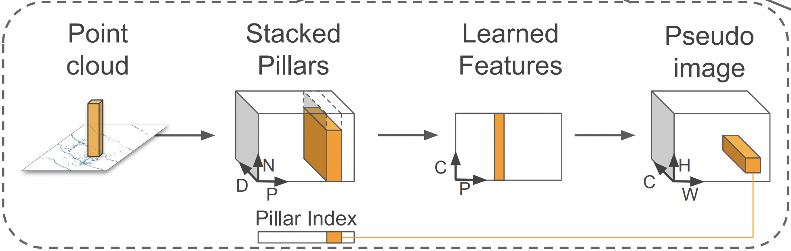




RT6 融合模型
P个非空柱子
特征提取
（PointNet）
对应回图像
$$\text{[}\text{D}\text{,}\text{N}\text{]}$$
$$\text{[}\text{D}\text{,}\text{P}\text{,}\text{N}\text{]}$$
$$\text{[}\text{C}\text{,}\text{P}\text{]}$$
$$\text{[}\text{C}\text{,}\text{H}\text{,}\text{W}\text{]}$$
（x,y,z,i,xc,yc,zc,xp,yp）
& max pooling
$120$m
Point Cloud
Voxel Encoder
Backbone
& Neck
pts feat
PointPillar
$$\text{[}\text{576}\text{,}\text{576}\text{,}\text{128}\text{]}$$
$−120$m
BG Head
$$点云范围$$
$$\text{[}\text{576}\text{,}\text{576}\text{,}\text{128}\text{]}$$
$−120$m
$120$m
pts&cam
Fusion
Temporal
fusion
$$\text{[}\text{576}\text{,}\text{576}\text{,}\text{128}\text{]}$$
4c
Fisheye
Backbone
$$\text{[}\text{4}\text{,}\text{64}\text{,}\text{96}\text{,}\text{144}\text{]}$$
FG Head
$$\text{[}\text{144}\text{,}\text{144}\text{,}\text{64}\text{]}$$
6c
Image
Backbone
C
cam2bev
cam feat
Far-sight
Backbone
C
Far sight
cam2bev
$$\text{[}\text{72}\text{,}\text{72}\text{,}\text{64}\text{]}$$
$200$m
1c
Far sight feat
$$\text{[}\text{1}\text{,}\text{64}\text{,}\text{96}\text{,}\text{144}\text{]}$$
$$Front cam feature$$

Slide 3
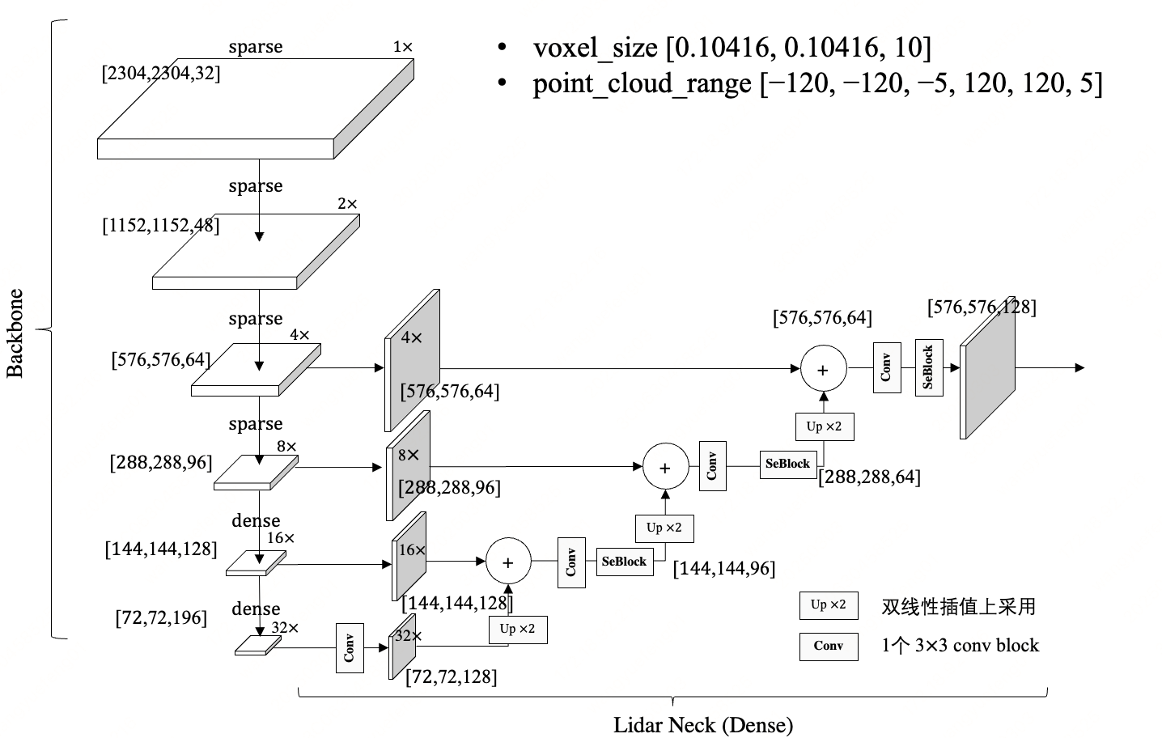
RT6 融合模型
分辨率变高了，voxel 20cm -> 10cm
稀疏卷积
$120$m
Point Cloud
Voxel Encoder
Backbone
& Neck
pts feat
$$\text{[}\text{576}\text{,}\text{576}\text{,}\text{128}\text{]}$$
$−120$m
BG Head
$$点云范围$$
$$\text{[}\text{576}\text{,}\text{576}\text{,}\text{128}\text{]}$$
$−120$m
$120$m
pts&cam
Fusion
Temporal
fusion
$$\text{[}\text{576}\text{,}\text{576}\text{,}\text{128}\text{]}$$
4c
Fisheye
Backbone
$$\text{[}\text{4}\text{,}\text{64}\text{,}\text{96}\text{,}\text{144}\text{]}$$
FG Head
$$\text{[}\text{144}\text{,}\text{144}\text{,}\text{64}\text{]}$$
6c
Image
Backbone
C
cam2bev
cam feat
Far-sight
Backbone
C
Far sight
cam2bev
$$\text{[}\text{72}\text{,}\text{72}\text{,}\text{64}\text{]}$$
$200$m
1c
Far sight feat
$$\text{[}\text{1}\text{,}\text{64}\text{,}\text{96}\text{,}\text{144}\text{]}$$
$$Front cam feature$$

Slide 4
RT6 融合模型
分辨率变高了，voxel 20cm -> 10cm
稀疏卷积
$120$m
Point Cloud
Voxel Encoder
Backbone
& Neck
pts feat
$$\text{[}\text{576}\text{,}\text{576}\text{,}\text{128}\text{]}$$
$−120$m
BG Head
$$点云范围$$
$$\text{[}\text{576}\text{,}\text{576}\text{,}\text{128}\text{]}$$
$−120$m
$120$m
pts&cam
Fusion
Temporal
fusion
$$\text{[}\text{576}\text{,}\text{576}\text{,}\text{128}\text{]}$$
4c
Fisheye
Backbone
$$\text{[}\text{4}\text{,}\text{64}\text{,}\text{96}\text{,}\text{144}\text{]}$$
FG Head
$$\text{[}\text{144}\text{,}\text{144}\text{,}\text{64}\text{]}$$
6c
Image
Backbone
C
cam2bev
cam feat
Far-sight
Backbone
C
Far sight
cam2bev
$$\text{[}\text{72}\text{,}\text{72}\text{,}\text{64}\text{]}$$
$200$m
1c
Far sight feat
$$\text{[}\text{1}\text{,}\text{64}\text{,}\text{96}\text{,}\text{144}\text{]}$$
$$Front cam feature$$

Slide 5
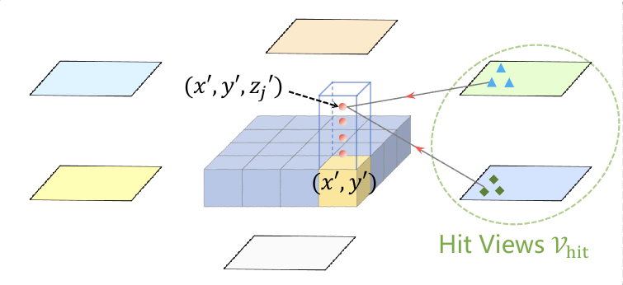
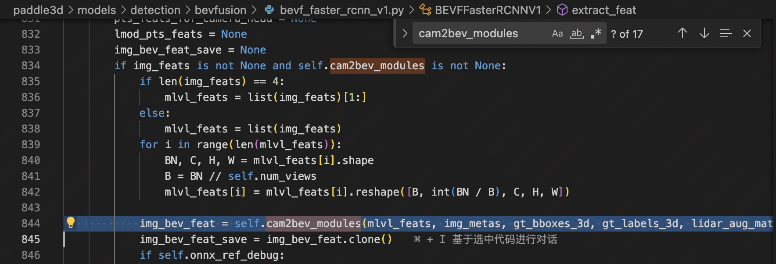
RT6 融合模型
在bev空间铺设 h*w 个 bev query，然后通过 spatial cross-attention 去图像空间提取特征更新 bev query 的特征，得到视觉bev特征
SpatialCrossAttention
$120$m
Point Cloud
Voxel Encoder
Backbone
& Neck
pts feat
$$\text{[}\text{576}\text{,}\text{576}\text{,}\text{128}\text{]}$$
$−120$m
BG Head
$$点云范围$$
$$\text{[}\text{576}\text{,}\text{576}\text{,}\text{128}\text{]}$$
$−120$m
$120$m
pts&cam
Fusion
Temporal
fusion
$$\text{[}\text{576}\text{,}\text{576}\text{,}\text{128}\text{]}$$
4c
Fisheye
Backbone
$$\text{[}\text{4}\text{,}\text{64}\text{,}\text{96}\text{,}\text{144}\text{]}$$
FG Head
$$\text{[}\text{144}\text{,}\text{144}\text{,}\text{64}\text{]}$$
6c
Image
Backbone
C
cam2bev
cam feat
Far-sight
Backbone
C
Far sight
cam2bev
$$\text{[}\text{72}\text{,}\text{72}\text{,}\text{64}\text{]}$$
$200$m
1c
Far sight feat
$$\text{[}\text{1}\text{,}\text{64}\text{,}\text{96}\text{,}\text{144}\text{]}$$
$$Front cam feature$$

Slide 6
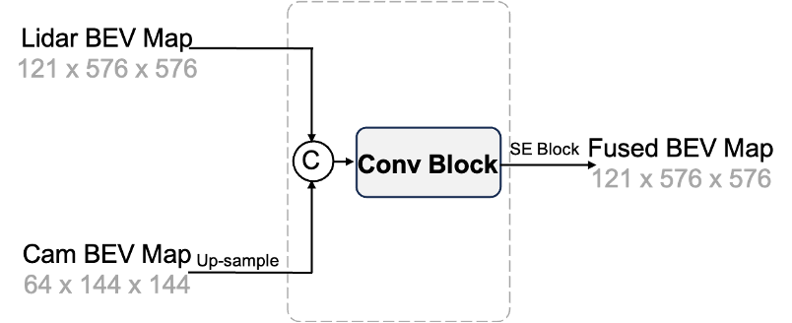
RT6 融合模型
BASE 结构
$120$m
Point Cloud
Voxel Encoder
Backbone
& Neck
pts feat
$$\text{[}\text{576}\text{,}\text{576}\text{,}\text{128}\text{]}$$
$−120$m
BG Head
$$点云范围$$
$$\text{[}\text{576}\text{,}\text{576}\text{,}\text{128}\text{]}$$
$−120$m
$120$m
pts&cam
Fusion
Temporal
fusion
$$\text{[}\text{576}\text{,}\text{576}\text{,}\text{128}\text{]}$$
4c
Fisheye
Backbone
$$\text{[}\text{4}\text{,}\text{64}\text{,}\text{96}\text{,}\text{144}\text{]}$$
FG Head
$$\text{[}\text{144}\text{,}\text{144}\text{,}\text{64}\text{]}$$
6c
Image
Backbone
C
cam2bev
cam feat
Far-sight
Backbone
C
Far sight
cam2bev
$$\text{[}\text{72}\text{,}\text{72}\text{,}\text{64}\text{]}$$
$200$m
1c
Far sight feat
$$\text{[}\text{1}\text{,}\text{64}\text{,}\text{96}\text{,}\text{144}\text{]}$$
$$Front cam feature$$

Slide 7
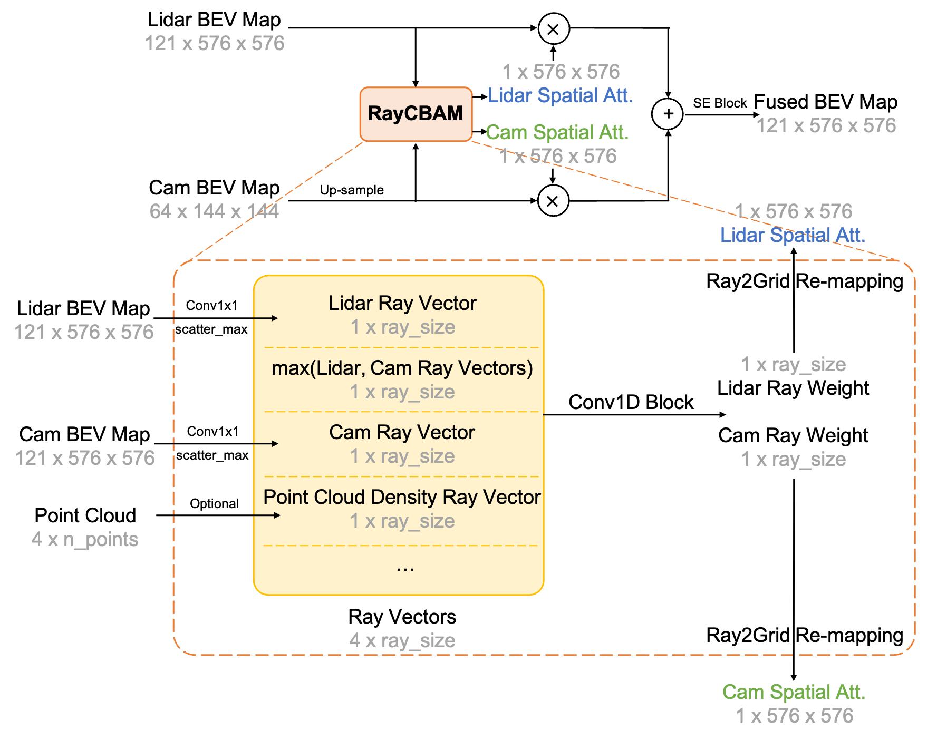
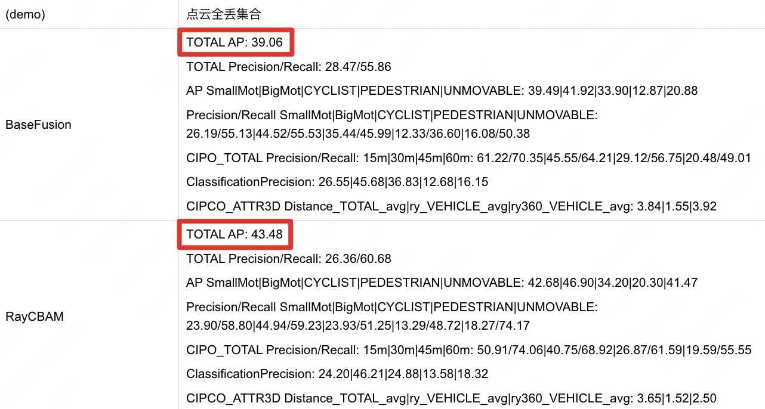
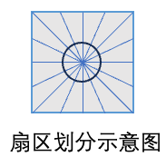
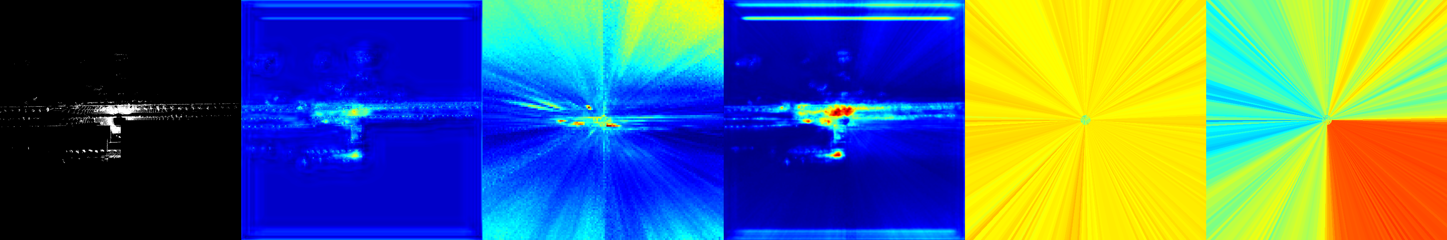
RT6 融合模型
BASE 结构
$120$m
Point Cloud
Voxel Encoder
Backbone
& Neck
pts feat
$$\text{[}\text{576}\text{,}\text{576}\text{,}\text{128}\text{]}$$
$−120$m
BG Head
$$点云范围$$
$$\text{[}\text{576}\text{,}\text{576}\text{,}\text{128}\text{]}$$
空间注意力融合RayCBAM
$−120$m
$120$m
pts&cam
Fusion
Temporal
fusion
$$\text{[}\text{576}\text{,}\text{576}\text{,}\text{128}\text{]}$$
4c
Fisheye
Backbone
$$\text{[}\text{4}\text{,}\text{64}\text{,}\text{96}\text{,}\text{144}\text{]}$$
FG Head
$$\text{[}\text{144}\text{,}\text{144}\text{,}\text{64}\text{]}$$
6c
Image
Backbone
C
cam2bev
cam feat
Far-sight
Backbone
C
Far sight
cam2bev
$$\text{[}\text{72}\text{,}\text{72}\text{,}\text{64}\text{]}$$
$200$m
1c
Far sight feat
点云
(右下扇区丢失)
$$\text{[}\text{1}\text{,}\text{64}\text{,}\text{96}\text{,}\text{144}\text{]}$$
Lidar BEV
Cam BEV
Fusion BEV
Lidar Weight
Cam Weight
$$Front cam feature$$

Slide 8
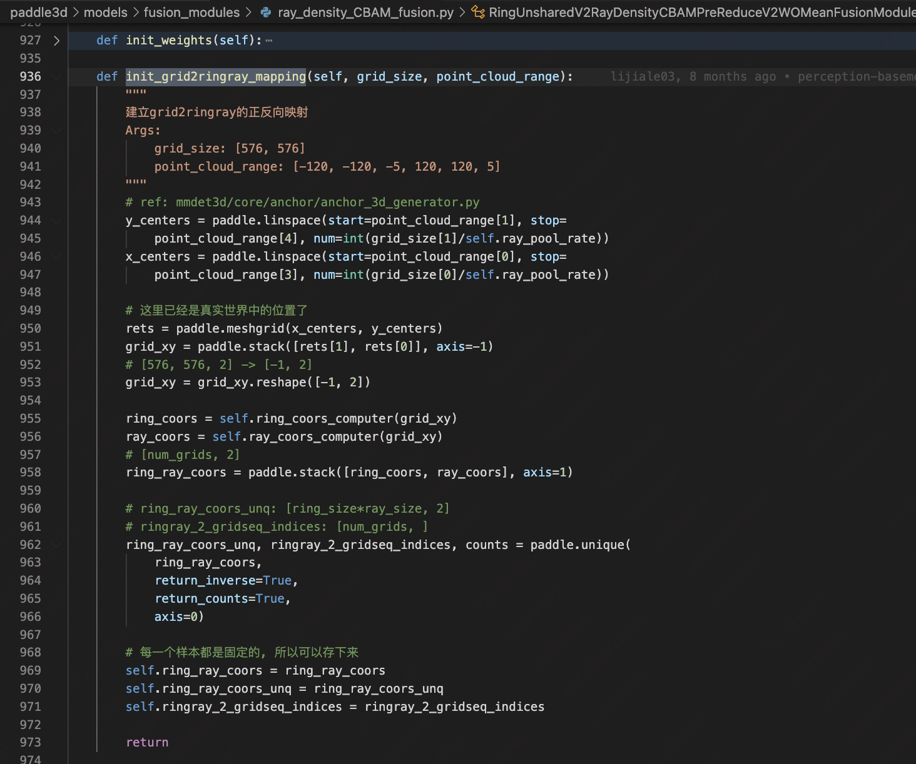
RT6 融合模型
获得网格中心点在真实世界的位置
创建网格坐标
BASE 结构
$120$m
Point Cloud
Voxel Encoder
Backbone
& Neck
pts feat
将笛卡尔坐标系的 grid_xy 转换为极坐标系的 ring 坐标和 ray 坐标
$$\text{[}\text{576}\text{,}\text{576}\text{,}\text{128}\text{]}$$
$−120$m
BG Head
$$点云范围$$
去除重复的坐标对，并得到唯一的 ring_ray 坐标

Slide 9
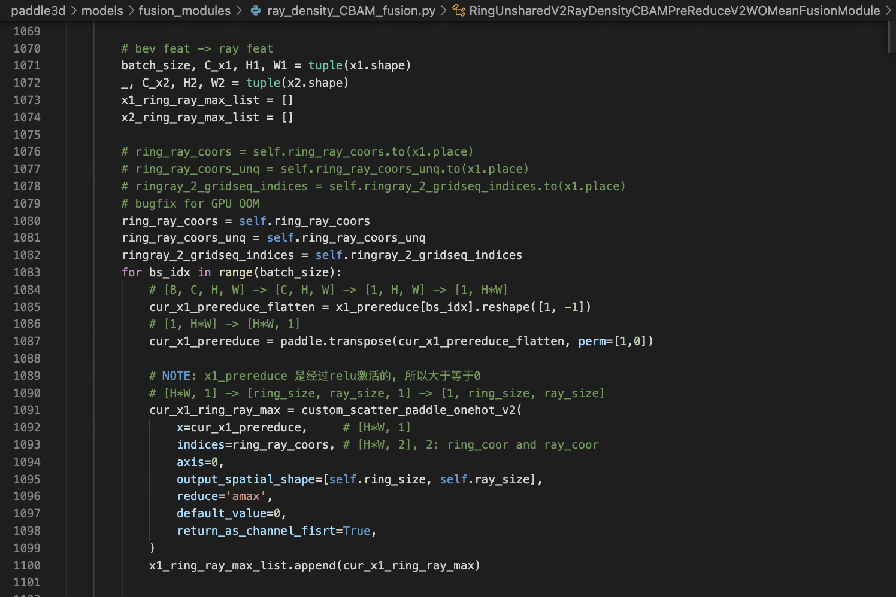
RT6 融合模型
BASE 结构
$120$m
将通道维度压缩为1
Point Cloud
Voxel Encoder
Backbone
& Neck
pts feat
$$\text{[}\text{576}\text{,}\text{576}\text{,}\text{128}\text{]}$$
$−120$m
BG Head
$$点云范围$$
在一个扇形分区中进行 scatter_max 操作，获得主要特征

Slide 10


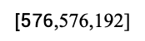

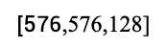

RT6 融合模型
bev_transform_matrix_last_frame
$$\text{[}\text{576}\text{,}\text{576}\text{,}\text{64}\text{]}$$
history_bev_feat
Conv1x1
history_bev_feat
history_bev_feat
Reduce dims
egomotion_align
$$\text{[}\text{576}\text{,}\text{576}\text{,}\text{128}\text{]}$$
$$\text{[}\text{576}\text{,}\text{576}\text{,}\text{64}\text{]}$$
mixed_feats
ConvBlocks
out
C
bev_feat
$$\text{[}\text{576}\text{,}\text{576}\text{,}\text{192}\text{]}$$
$$\text{[}\text{576}\text{,}\text{576}\text{,}\text{128}\text{]}$$
$$\text{[}\text{576}\text{,}\text{576}\text{,}\text{128}\text{]}$$
$120$m
Point Cloud
Voxel Encoder
Backbone
& Neck
pts feat
$$\text{[}\text{576}\text{,}\text{576}\text{,}\text{128}\text{]}$$
$−120$m
BG Head
$$点云范围$$
$$\text{[}\text{576}\text{,}\text{576}\text{,}\text{128}\text{]}$$
$−120$m
$120$m
pts&cam
Fusion
Temporal
fusion
$$\text{[}\text{576}\text{,}\text{576}\text{,}\text{128}\text{]}$$
4c
Fisheye
Backbone
$$\text{[}\text{4}\text{,}\text{64}\text{,}\text{96}\text{,}\text{144}\text{]}$$
FG Head
$$\text{[}\text{144}\text{,}\text{144}\text{,}\text{64}\text{]}$$
6c
Image
Backbone
C
cam2bev
cam feat
Far-sight
Backbone
C
Far sight
cam2bev
$$\text{[}\text{72}\text{,}\text{72}\text{,}\text{64}\text{]}$$
$200$m
1c
Far sight feat
$$\text{[}\text{1}\text{,}\text{64}\text{,}\text{96}\text{,}\text{144}\text{]}$$
$$Front cam feature$$

Slide 11
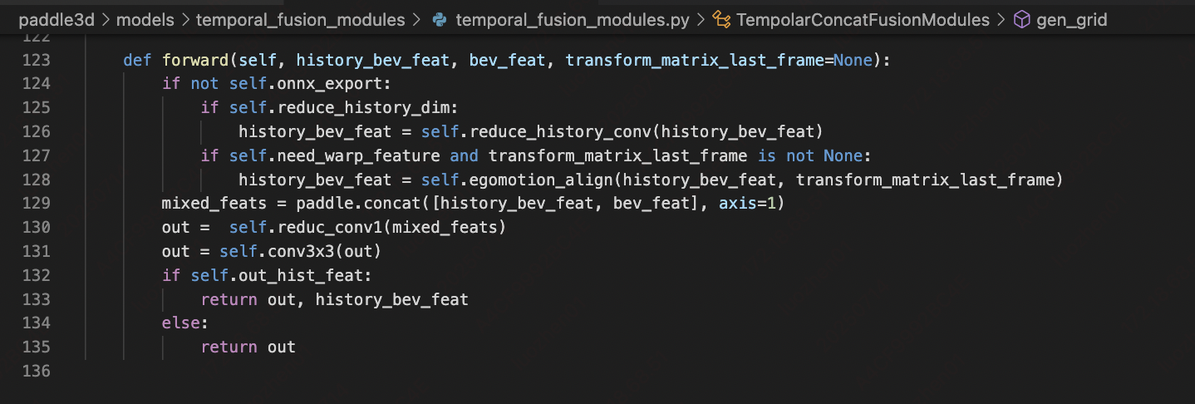
RT6 融合模型
bev_transform_matrix_last_frame
$$\text{[}\text{576}\text{,}\text{576}\text{,}\text{64}\text{]}$$
history_bev_feat
Conv1x1
history_bev_feat
history_bev_feat
Reduce dims
egomotion_align
$$\text{[}\text{576}\text{,}\text{576}\text{,}\text{128}\text{]}$$
$$\text{[}\text{576}\text{,}\text{576}\text{,}\text{64}\text{]}$$
mixed_feats
ConvBlocks
out
C
bev_feat
$$\text{[}\text{576}\text{,}\text{576}\text{,}\text{192}\text{]}$$
$$\text{[}\text{576}\text{,}\text{576}\text{,}\text{128}\text{]}$$
$$\text{[}\text{576}\text{,}\text{576}\text{,}\text{128}\text{]}$$
$120$m
Point Cloud
Voxel Encoder
Backbone
& Neck
pts feat
$$\text{[}\text{576}\text{,}\text{576}\text{,}\text{128}\text{]}$$
$−120$m
BG Head
$$点云范围$$
$$\text{[}\text{576}\text{,}\text{576}\text{,}\text{128}\text{]}$$
$−120$m
$120$m
pts&cam
Fusion
Temporal
fusion
$$\text{[}\text{576}\text{,}\text{576}\text{,}\text{128}\text{]}$$
4c
Fisheye
Backbone
$$\text{[}\text{4}\text{,}\text{64}\text{,}\text{96}\text{,}\text{144}\text{]}$$
FG Head
$$\text{[}\text{144}\text{,}\text{144}\text{,}\text{64}\text{]}$$
6c
Image
Backbone
C
cam2bev
cam feat
Far-sight
Backbone
C
Far sight
cam2bev
$$\text{[}\text{72}\text{,}\text{72}\text{,}\text{64}\text{]}$$
$200$m
1c
Far sight feat
$$\text{[}\text{1}\text{,}\text{64}\text{,}\text{96}\text{,}\text{144}\text{]}$$
$$Front cam feature$$

Slide 12
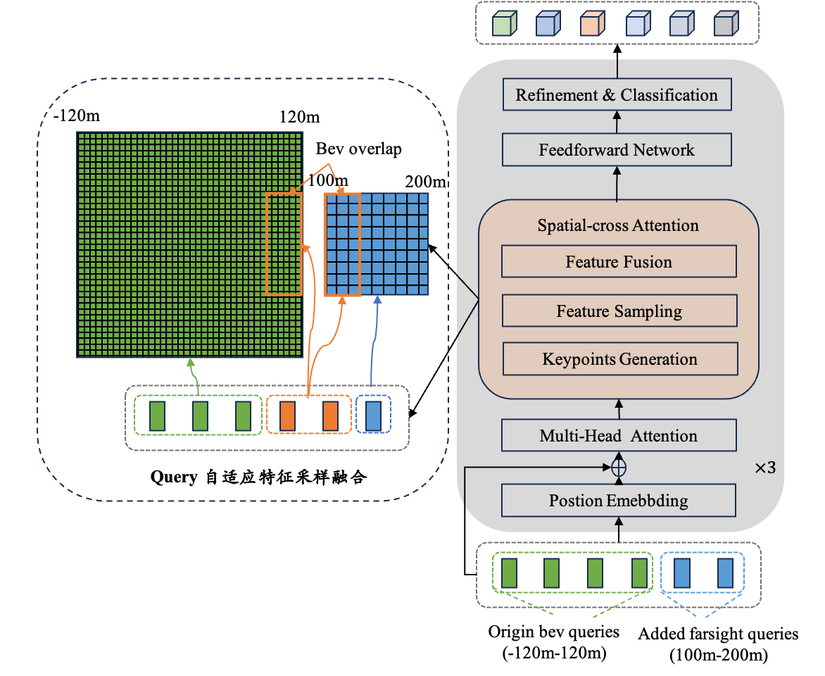
RT6 融合模型
主要特点：
环视bev与远视距bev分辨率不同，适应检测精度；
远视距query初始化覆盖远视距bev检测范围；
环视query与远视距query模型内部不做区分，编解码同构；
query自适应与bev特征采样融合。
$120$m
Point Cloud
Voxel Encoder
Backbone
& Neck
pts feat
$$\text{[}\text{576}\text{,}\text{576}\text{,}\text{128}\text{]}$$
$−120$m
BG Head
$$点云范围$$
$$\text{[}\text{576}\text{,}\text{576}\text{,}\text{128}\text{]}$$
$−120$m
$120$m
pts&cam
Fusion
Temporal
fusion
$$\text{[}\text{576}\text{,}\text{576}\text{,}\text{128}\text{]}$$
4c
Fisheye
Backbone
$$\text{[}\text{4}\text{,}\text{64}\text{,}\text{96}\text{,}\text{144}\text{]}$$
FG Head
$$\text{[}\text{144}\text{,}\text{144}\text{,}\text{64}\text{]}$$
6c
Image
Backbone
C
cam2bev
cam feat
Far-sight
Backbone
C
Far sight
cam2bev
$$\text{[}\text{72}\text{,}\text{72}\text{,}\text{64}\text{]}$$
$200$m
1c
Far sight feat
$$\text{[}\text{1}\text{,}\text{64}\text{,}\text{96}\text{,}\text{144}\text{]}$$
$$Front cam feature$$

Slide 13
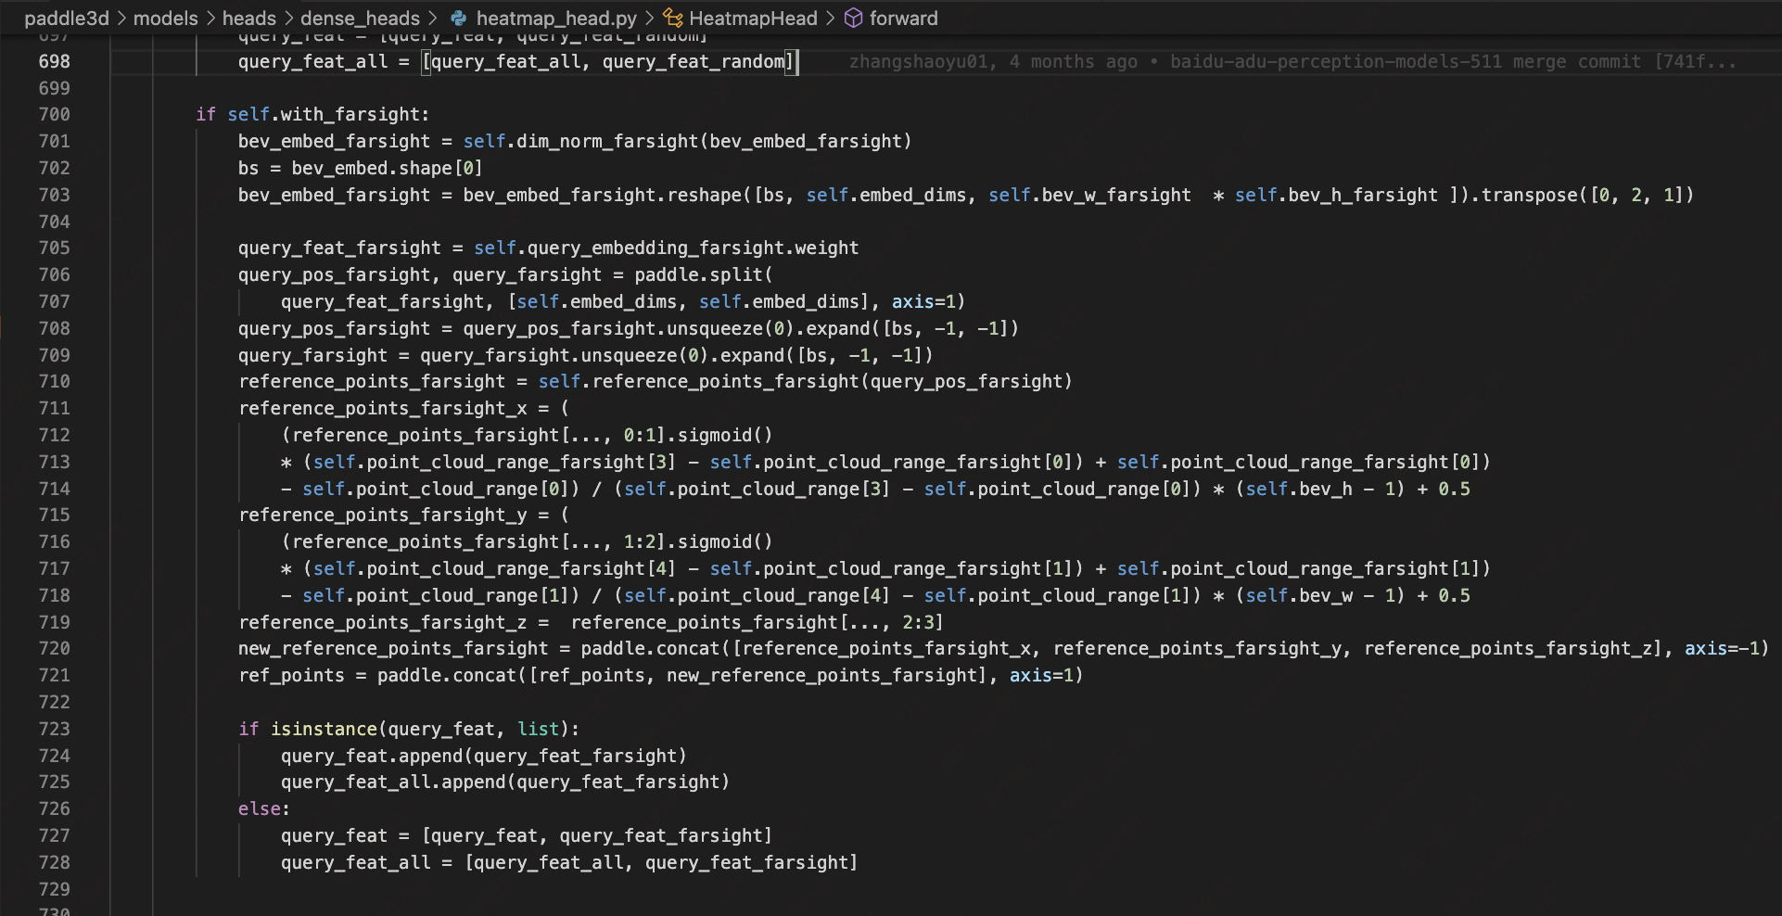
RT6 融合模型
主要特点：
环视bev与远视距bev分辨率不同，适应检测精度；
远视距query初始化覆盖远视距bev检测范围；
环视query与远视距query模型内部不做区分，编解码同构；
query自适应与bev特征采样融合。
参考点（Reference Points）计算：
先通过 self.reference_points_farsight (linear layer) 得到原始参考点，再将 X、Y 坐标从 实际点云范围 映射到 BEV 特征图网格坐标（farsight 生效范围），得到 new_reference_points_farsight，并和环视 BEV 的 ref_points 拼接。
$120$m
Point Cloud
Voxel Encoder
Backbone
& Neck
pts feat
$$\text{[}\text{576}\text{,}\text{576}\text{,}\text{128}\text{]}$$
$−120$m
BG Head
$$点云范围$$
$$\text{[}\text{576}\text{,}\text{576}\text{,}\text{128}\text{]}$$
$−120$m
$120$m
pts&cam
Fusion
Temporal
fusion
$$\text{[}\text{576}\text{,}\text{576}\text{,}\text{128}\text{]}$$
4c
Fisheye
Backbone
$$\text{[}\text{4}\text{,}\text{64}\text{,}\text{96}\text{,}\text{144}\text{]}$$
FG Head
$$\text{[}\text{144}\text{,}\text{144}\text{,}\text{64}\text{]}$$
6c
Image
Backbone
C
cam2bev
cam feat
Far-sight
Backbone
C
Far sight
cam2bev
$$\text{[}\text{72}\text{,}\text{72}\text{,}\text{64}\text{]}$$
$200$m
1c
Far sight feat
$$\text{[}\text{1}\text{,}\text{64}\text{,}\text{96}\text{,}\text{144}\text{]}$$
$$Front cam feature$$

Slide 14








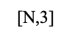
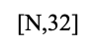
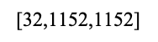
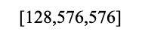
RT6 融合模型
bev_to_point_idx_x
$$\text{[}\text{N}\text{,}\text{3}\text{]}$$
特征增强
上采样
x
x
bev_x
bev2pts_feature
Head_neck
deconv1
gather_point_feature
$$\text{[}\text{128}\text{,}\text{576}\text{,}\text{576}\text{]}$$
$$\text{[}\text{128}\text{,}\text{576}\text{,}\text{576}\text{]}$$
$$\text{[}\text{32}\text{,}\text{1152}\text{,}\text{1152}\text{]}$$
$$\text{[}\text{N}\text{,}\text{3}\text{2}\text{]}$$
conv_parser
output_parser_bev
conv_sbr
$$\text{[}\text{7}\text{,}\text{1152}\text{,}\text{1152}\text{]}$$
output_sbr_bev
$$\text{[}\text{4}\text{,}\text{1152}\text{,}\text{1152}\text{]}$$
$120$m
from Voxel Encoder (PointPillar)
Point Cloud
Voxel Encoder
Backbone
& Neck
parser_p_x
C
output_parser_pts
parser_pts_conv
pts feat
pts_conv_parser
$−120$m
$$\text{[}\text{576}\text{,}\text{576}\text{,}\text{128}\text{]}$$
BG Head
$$\text{[}\text{N}\text{,}\text{32}\text{]}$$
$$\text{[}\text{N}\text{,}\text{7}\text{]}$$
pts_fea
$$点云范围$$
pts_x
sbr_p_x
$$\text{[}\text{576}\text{,}\text{576}\text{,}\text{128}\text{]}$$
output_sbr_pts
C
$−120$m
$120$m
point_deconv
sbr_pts_conv
pts_conv_sbr
pts&cam
Fusion
Temporal
fusion
$$\text{[}\text{576}\text{,}\text{576}\text{,}\text{128}\text{]}$$
$$\text{[}\text{N}\text{,}\text{64}\text{]}$$
$$\text{[}\text{N}\text{,}\text{16}\text{]}$$
$$\text{[}\text{N}\text{,}\text{32}\text{]}$$
$$\text{[}\text{N}\text{,}\text{4}\text{]}$$
Fisheye
Backbone
$$\text{[}\text{4}\text{,}\text{64}\text{,}\text{96}\text{,}\text{144}\text{]}$$
FG Head
4c
flow_pts_conv
flow_p_x
C
output_velocity_pts
$$\text{[}\text{144}\text{,}\text{144}\text{,}\text{64}\text{]}$$
pts_conv_velocity
Image
Backbone
C
cam2bev
$$\text{[}\text{N}\text{,}\text{32}\text{]}$$
$$\text{[}\text{N}\text{,}\text{2}\text{]}$$
6c
cam feat
Far-sight
Backbone
C
Far sight
cam2bev
$$\text{[}\text{72}\text{,}\text{72}\text{,}\text{64}\text{]}$$
$200$m
1c
Far sight feat
$$\text{[}\text{1}\text{,}\text{64}\text{,}\text{96}\text{,}\text{144}\text{]}$$
$$Front cam feature$$

